Slide 1

UBER SUPPLY- DEMAND GAP
Devanshi Kulshreshtha

Slide 2
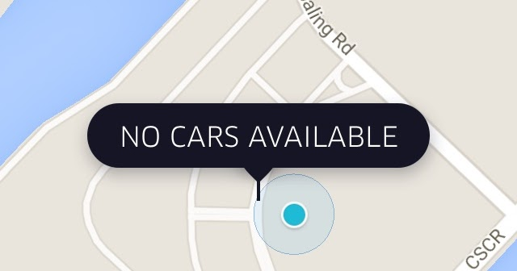
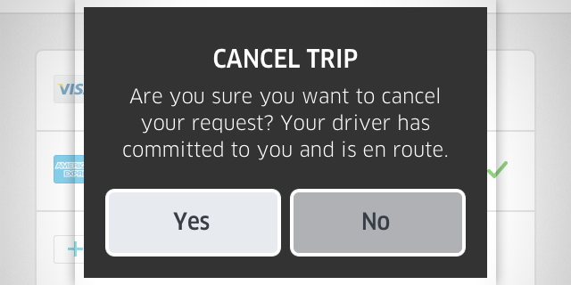
Abstract
The availability of cars for travel to and from the airport is a problem many a potential customers face. The lack of reliability of getting a ride could spurn away many potential customers, leading to loss of potential revenue.
This is remedied by looking at demand of cars to an from the airport. The data corresponds to over 6700 requests made over 5 days in 2017 at various times of the day.
In this study, we will identify the root cause of the problem (i.e. cancellation and non-availability of cars) and recommend ways to improve the situation.
Sources:
https://www.techinasia.com/count-uber-home-midnight-india-heres

Slide 3
Business & Data Understanding
Data
Preprocessing
Visual Plots & Insights
Recommendations
Specifying the objective-Problems faced by customers in booking rides to the airport leads to a huge revenue impact on Uber
Data
Information of over 6000 requests raised for trips to and from the airport for 6 days was used for the analysis
Understanding the datasets – Details of over 6000 datasets was available. 48% of the data was of requests raised from the airport, and were the remaining from the city. The status of the trips was recorded as completed, cancelled, or no cars available.
Cleaning the data- Data quality issues were identified and dealt with.
Trip status was assessed against various metrics- pickup point and time of day.
The gap in demand and supply was assessed as differences in requests raised in the city versus at the airport- the supply of cars at the airport comes from cars going to the airport.
R (ggplot2) was used for creating the plots
Based on take-off and landing time of flights, there seems to be a lot of gaps in supply and demand at various hours of the day.
Demand-supply shows similar patterns by hour of day on all days in question- this information could be passed along to driver partners.
Uber could incentivize drivers to show up at the airport at peak hours.
Cab sharing can be introduced to meet the low supply of cars.

Slide 4
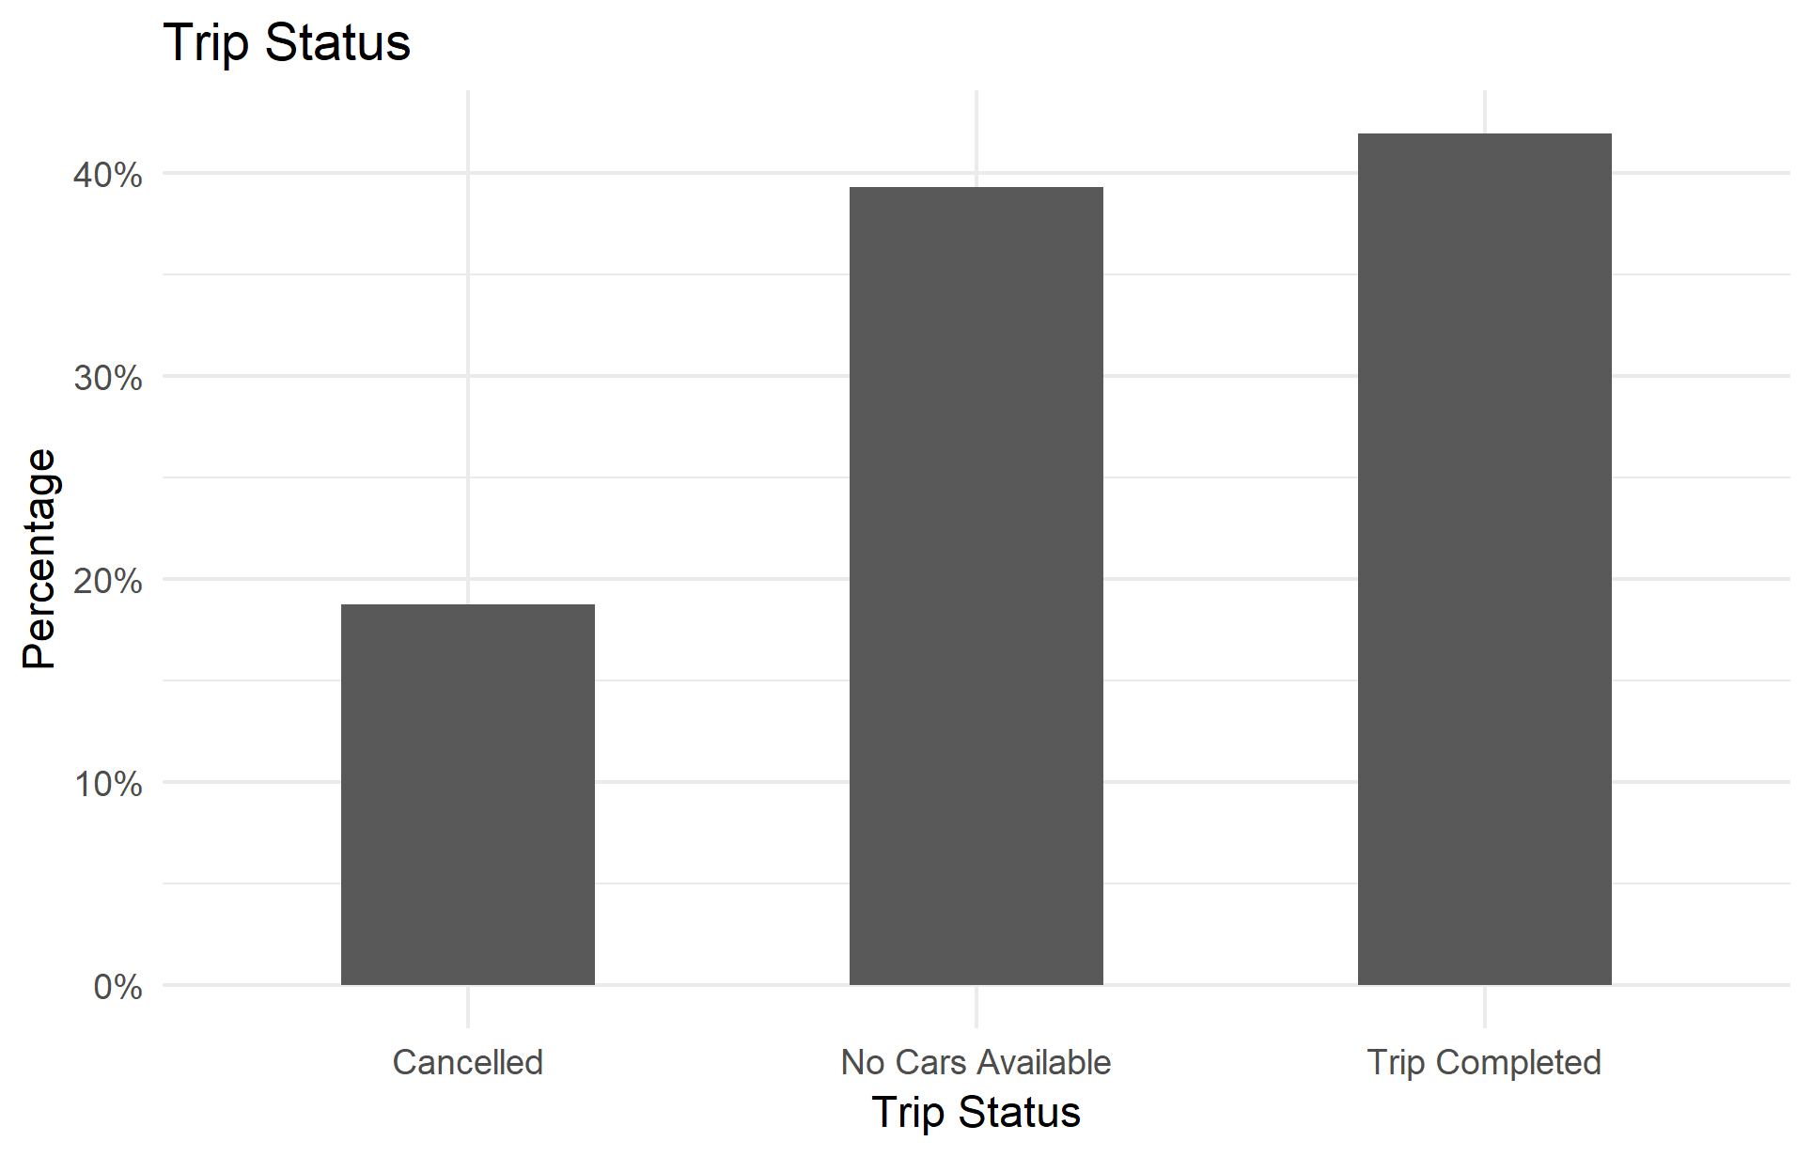
How severe is the problem?
Less than 50% of the requests generated are completed.
Close to 40% of the requests generated are met by unavailability of cars.
This could mean substantial losses in potential revenue.

Slide 5
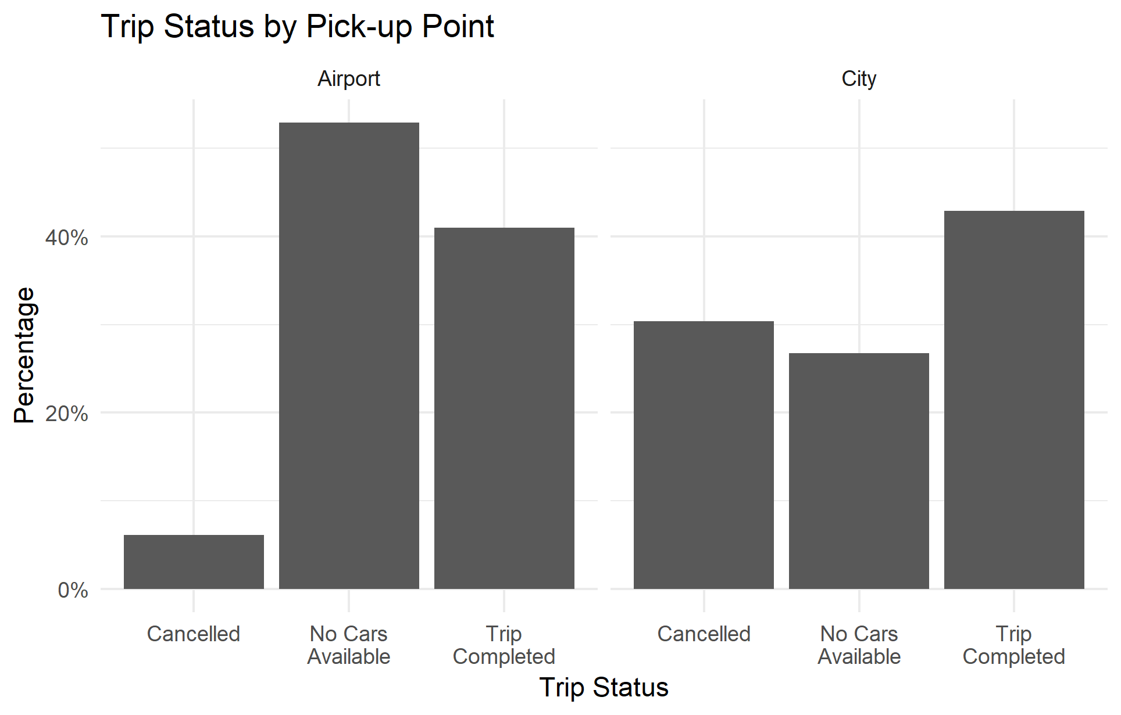
Does it matter where the trips are generated?
The origin of the request does not matter- the statistics on trip completion look bad irrespective of the pickup point. Only about 40% of the requests generated are completed.
Requests generated at the airport are more likely to be met by lack of availability of cars.

Slide 6
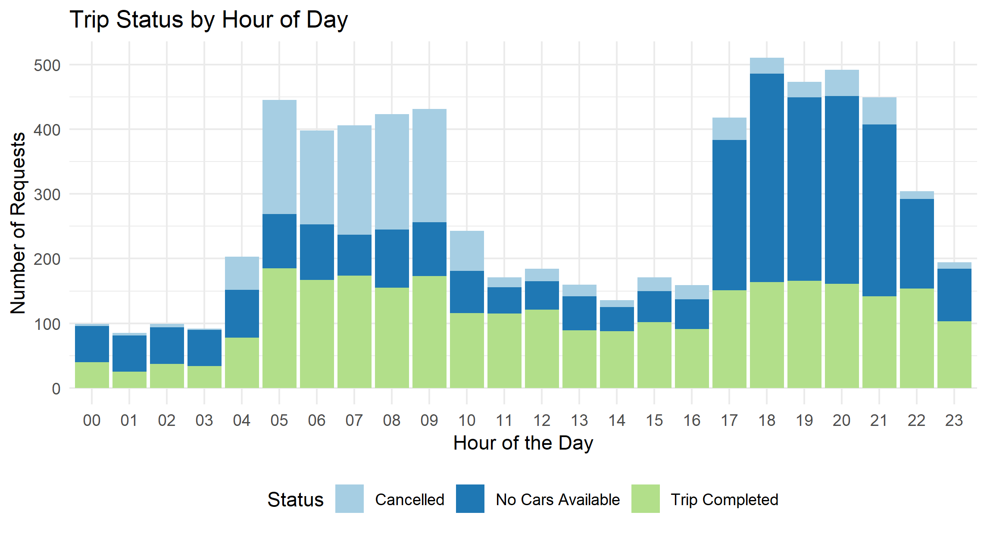
Are certain times of the day more vulnerable?
Certain times of the day have a higher completion to request ratio.
There is variability in how well a demand is met through the day.
12 pm is the best chance of having a complete trip available to the customer.
The “best” hour of the day sees a completion of just below 75% of requests generated.
The gap is much worse is early morning hours (between 12-4 am) and in the evening (5-9 pm)

Slide 7
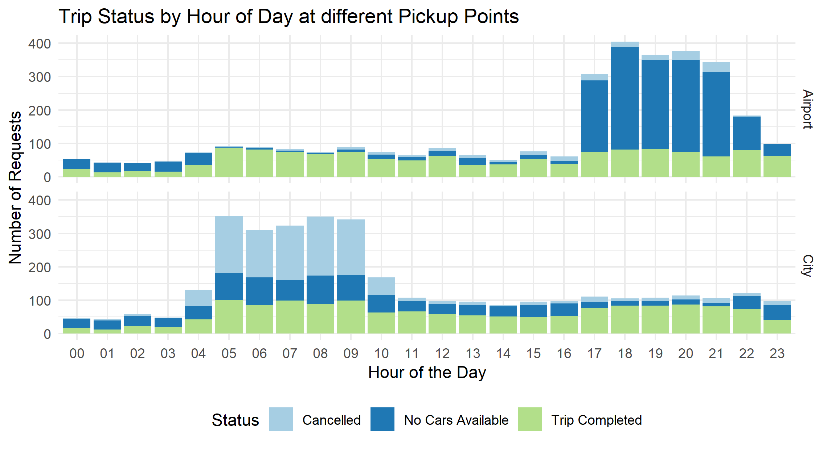
Does pick-up point matter?
Different times of the day have different success rates for customers. It further depends on the pickup point:
Getting rides from the airport is easier at early hours of the morning (5 am to 8 am).
Leaving the airport during early morning or late evening hours is tricky at best.
Getting to the airport is relatively easier if one has a flight in late evening: (6 pm to 9 pm).
Going to the airport is met by higher cancellation to requests ratio- specially in early morning hours (4 am to 9 am).

Slide 8
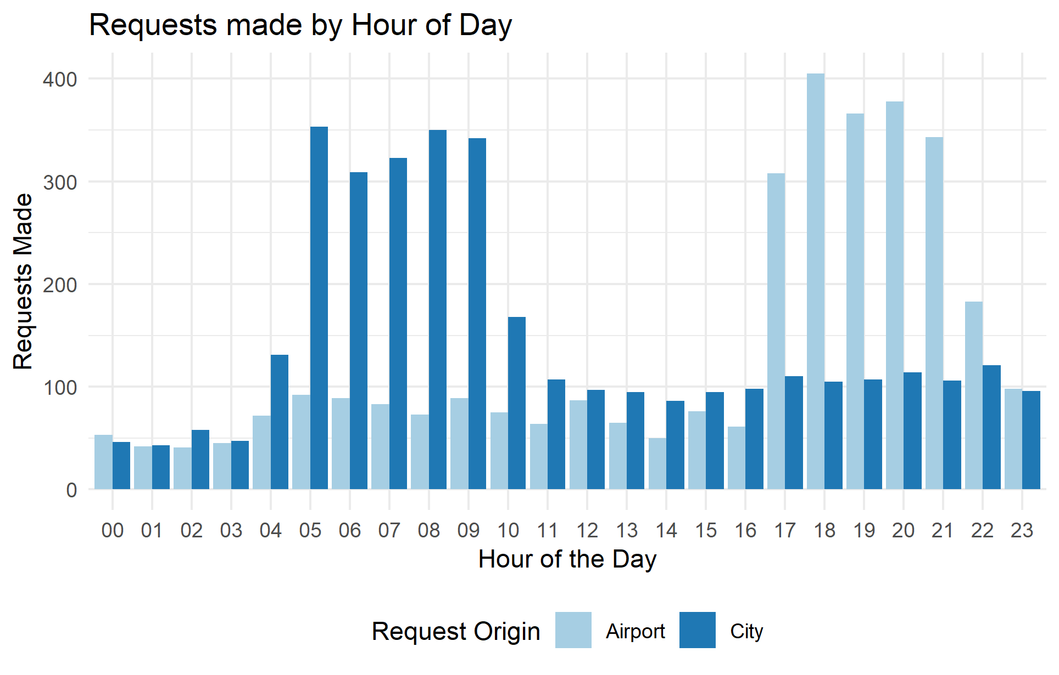
Demand and Supply Gap
Due to travel time and fuel charges, drivers would be unlikely to travel to the airport alone (without a rider).
Trips from the city to the airport contribute to the supply of cars at the airport, and cars going from the airport to the city contribute to the supply in the city.
A demand and supply disequilibrium is created because of these differences- there is greater demand in the city in early morning hours and greater demand at the airport during evening.

Slide 9
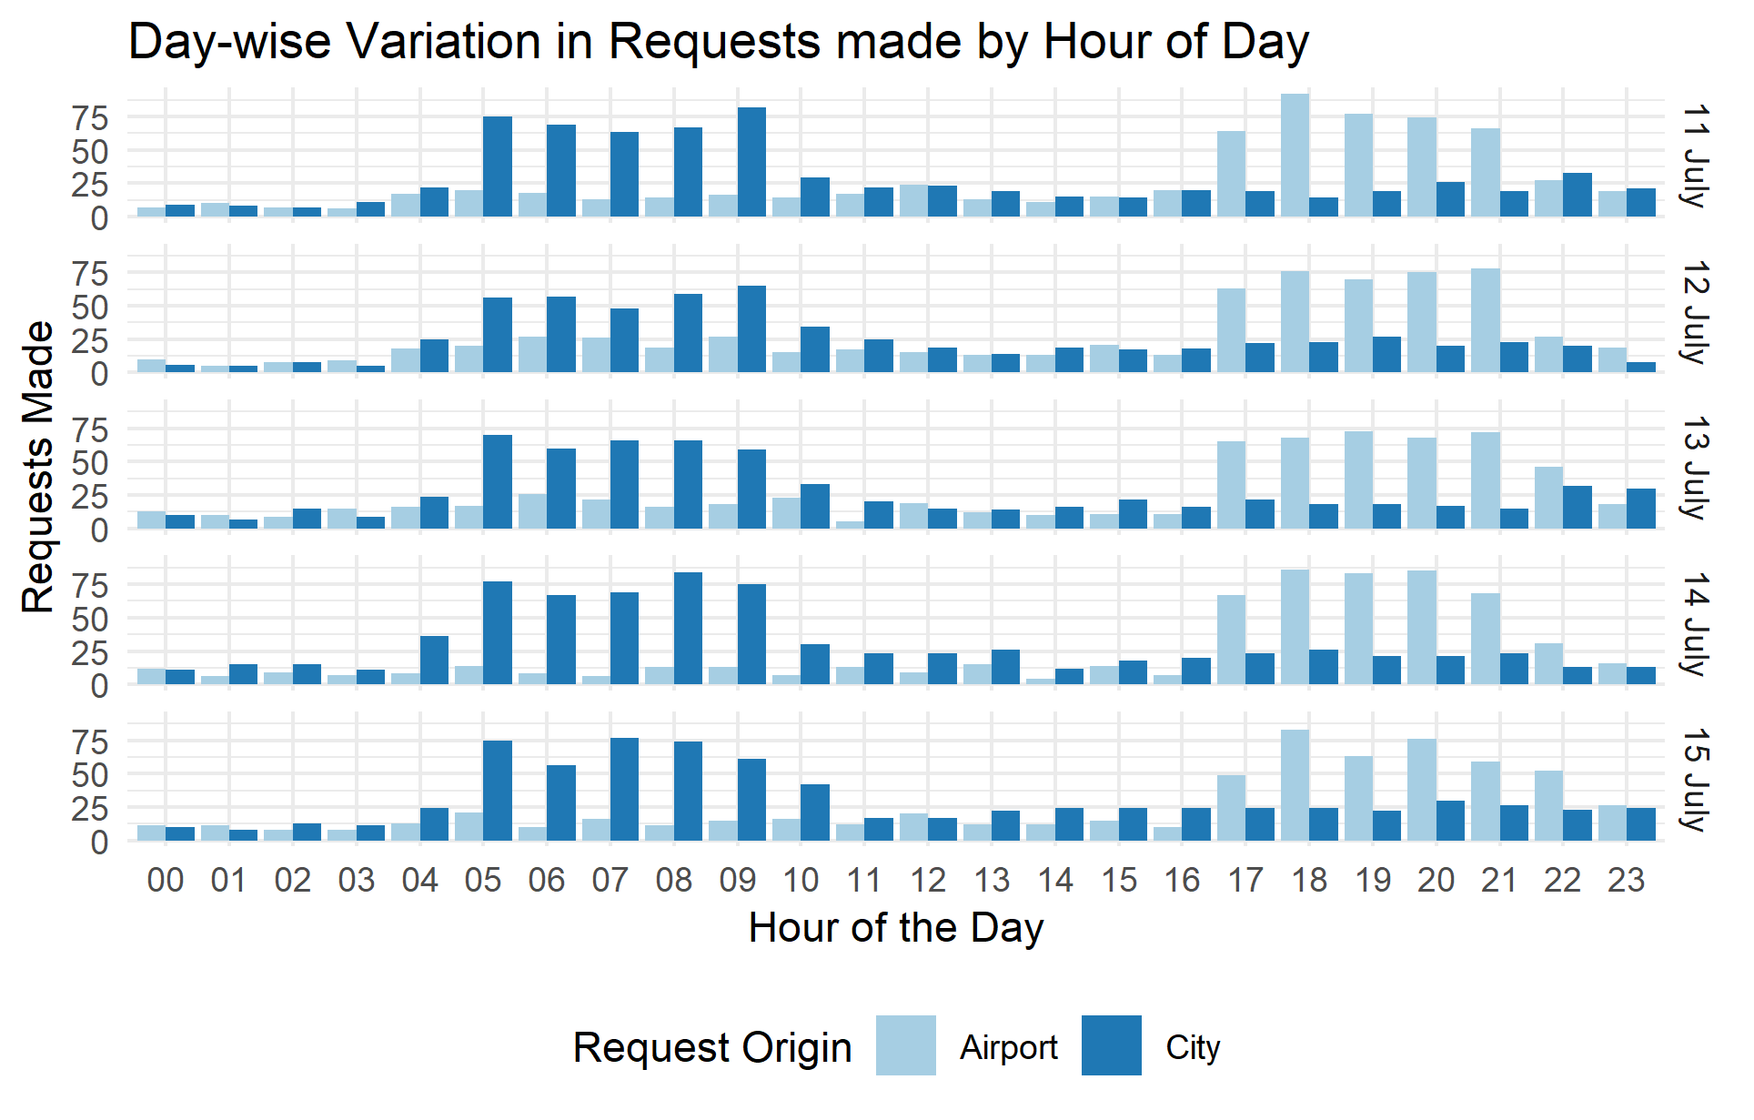
Demand and Supply Gap
The peak demand at the airport/city is a pattern that is seen across all days.
This could be because more domestic flights take off in the morning. International flights tend to arrive late at night, thus contributing to greater demand at the airport during these hours.

Slide 10
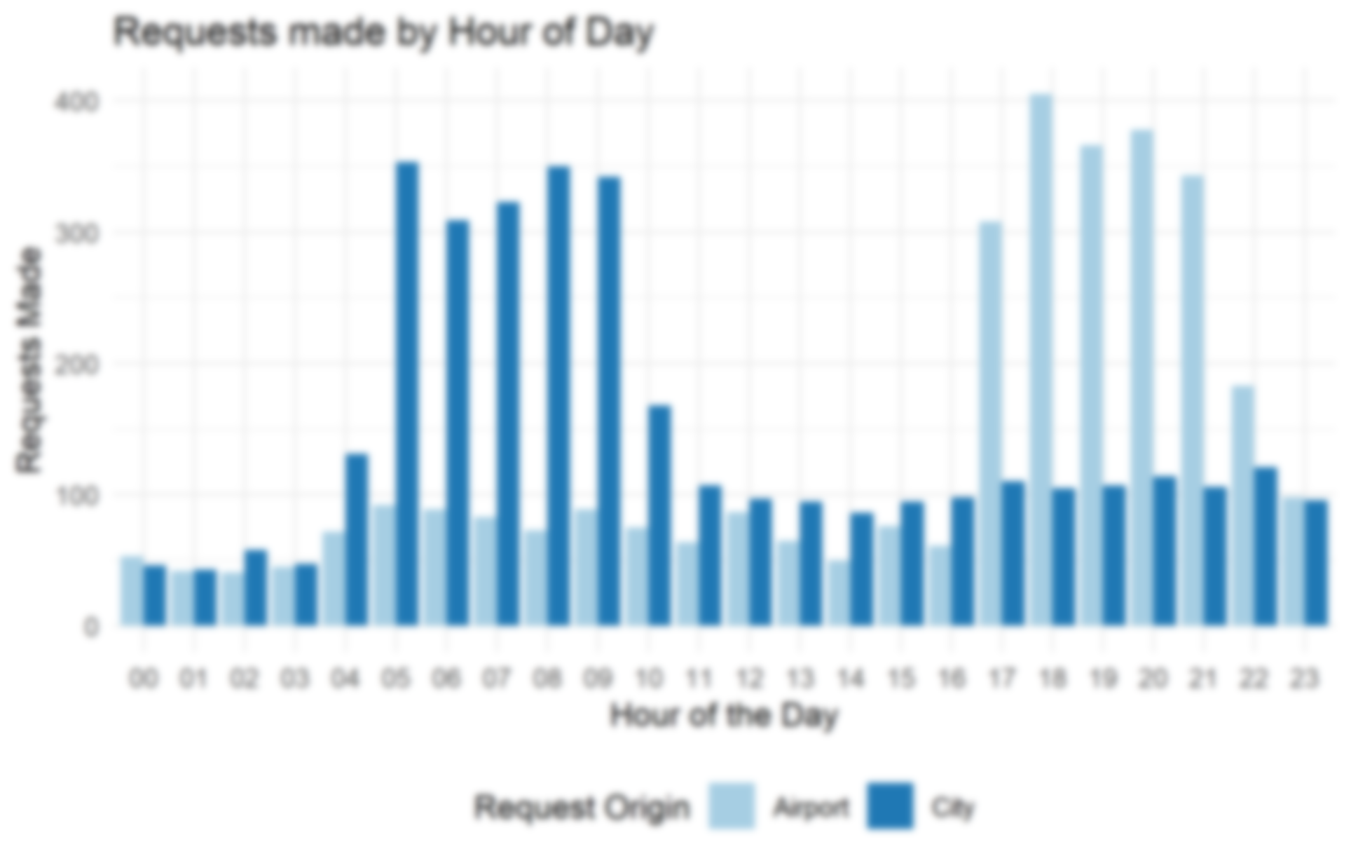
Demand and Supply Gap
Flight frequency would be an important factor leading up to the demand-supply mismatch. More flights take off in early morning hours- contributing to a higher demand.
On the other hand, late evening is when a lot of flights (international ones typically) land. This contributes to a huge demand for cars from the airport to the city. But there is not much supply at the airport, as a not a lot of cars travel.
Waiting is not ideal for driver partners. Driver Idle time eats away at the revenue they could be generating by being in higher demand

Slide 11

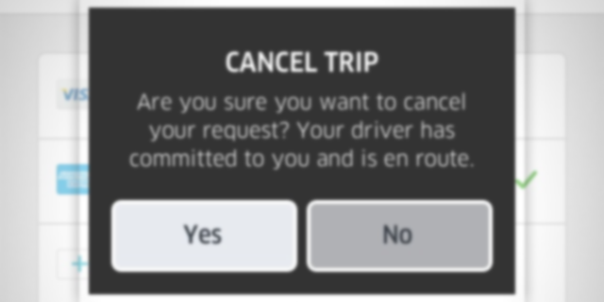
Recommendations
The assumption that “If a driver has switched on his device and he is logged on, he should be willing to take a rider anywhere in the city” needs to be relaxed. The incentive structure has to be conducive to the needs of Uber’s driver partners as well.
Waiting around the airport is not feasible for driver partners.
Demand patterns the same trend over several days. This information can be shared with the drivers before hand.
Drivers can be incentivised to take trips to the airport around “peak” hours
Ride sharing could be encouraged for trips to and from the airport.

